Slide 1
CAMP HPC seminar
Edwin Solares
Ecology and Evolutionary Biology
Comparative Genomics
BD Fellow

Slide 2
What is an hpc?
High Performance Computing Cluster

Slide 3
Cores, gpus and foobar?
Cores = A single processor task
GPU = A graphics card used for scientific computing
Memory = workspace for a task
Storage Filesystem = “permanent” storage, slow
Scratch Filesystem = temporary storage, fast
Node = 1 logical/physical server
Foobar? Foo + bar
Foo + bar

Slide 4
Special nodes
Login Nodes
Interactive Nodes
Scheduler Nodes
Job Nodes

Slide 5
Que scheduling systems
Server Types: SGE, SLURM, etc.
What is a queue?
What is a cluster?

Slide 6
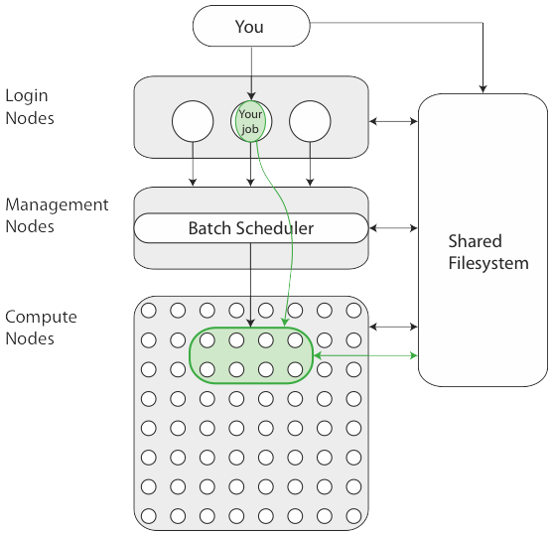
HPC Cluster layout
Login Nodes
Scheduler
Compute Nodes
and
Queues

Slide 7
Types of jobs
Single vs Multi Task/Core
Single vs Multi Node
GPU
Memory Intensive
Simulations
Computational/Calculations
Matrix/Vectors
Examples?
Notes:
Examples: protein interactions, Climate models, genome assembly, material stress models, machine learning, optimization, mathematical proofs.

Slide 8
resources
UCI HPC
XSEDE
Private HPC (google, amazon)

Slide 9
Uci hpc
Mostly AMD Nodes
32 and 64 Core Nodes
Usually 256GB and 512GB per Node

Slide 10
xsede
Access to variety of HPC Clusters
Resource based allotment and purchases
What is an SU?
(1 SU / 1 core-hour) * 32 cores * 48 hours = 1,536 SU’s

Slide 11
Xsede Grants
Startup (usually less than 200,000/50,000 SU’s)
Research (can be larger than 200,000/50,000 SU’s)
Fellowship (awarded via GRFP)
Teaching (limitations similar to Startup)
https://portal.xsede.org/allocations-overview#sulimits

Slide 12

Getting around
df
/home
Think Super Mario Bros.
/home/edwin
/home/edwin/bc
/home/edwin/gene

Slide 13

Pipe maze
df
AVOID!!!
Make filenames, extensions and directories informative

Slide 14
Always use interactive nodes

Slide 15

Questions?

Slide 16
Interactive time!
Load up your favorite ssh terminal
https://github.com/esolares/hpc_tutorial

Slide 17
Command cheat sheet
pwd Where am i?
cd <destination> change directory
../ up one level ./ current level ./<directory> go to <directory>
ls <destination> list contents of directory
bash <filename> runs <filename> in terminal
qsub <filename> submits <filename> script to the scheduler

